Slide 1
Enhancing Urban Mobility: A Comprehensive Study on the BEST Bus Service in Mumbai
As urbanization continues to accelerate, efficient and sustainable urban mobility solutions are imperative to address the growing transportation challenges in metropolitan areas. This comprehensive study focuses on enhancing urban mobility through an in-depth analysis of bus services, aiming to identify and promote the best practices for a more effective and passenger-friendly transit system.

Slide 2
Abstract
Efficient and sustainable urban mobility solutions are essential for metropolitan areas
The study focuses on enhancing urban mobility through an analysis of bus services
The goal is to identify and promote best practices for a more effective transit system

Slide 3
Introduction
Dedicated study on the excellence of the BEST bus service in Mumbai
This comprehensive study is dedicated to dissecting and analyzing the facets that contribute to the excellence of the BEST bus service. The sprawling cityscape, with its unique challenges and opportunities, warrants a focused examination of the intricacies of this iconic public transportation system. By undertaking a thorough investigation into the operational, infrastructural, and socio-economic dimensions of the BEST bus service, this research aims to unveil insights that can serve as a model for urban mobility solutions.
This comprehensive study is dedicated to dissecting and analyzing the facets that contribute to the excellence of the BEST bus service. The sprawling cityscape, with its unique challenges and opportunities, warrants a focused examination of the intricacies of this iconic public transportation system. By undertaking a thorough investigation into the operational, infrastructural, and socio-economic dimensions of the BEST bus service, this research aims to unveil insights that can serve as a model for urban mobility solutions.

Slide 4
Objectives of study
To Evaluate Accessibility and Inclusivity
To contribute to academic discussions and knowledge
To Assess Affordability and Fare Structure

Slide 5
Review of Literature
Badami S. (2005) surveyed in the research paper about the Bus Rapid Transit System (BRTS) for the region of Mumbai which would cover three routes of the east-west trunk and about five north-south routes as the most economic method to alleviate the issue of regular congestion as well as of the massive overcrowding.
Litman T, (2008), Introduction of the concept of sustainability in transport provision has lead to a paradigm shift from the existing transport planning practices. Although less, there have been a few initiatives by city planners to plan for equitable, efficient and environment-friendly transport systems. City planners have now started viewing transport beyond the traditional concept of just physical mobility to a broader concept of accessibility i.e. people’s ability to obtain desired goods and services.

Slide 6
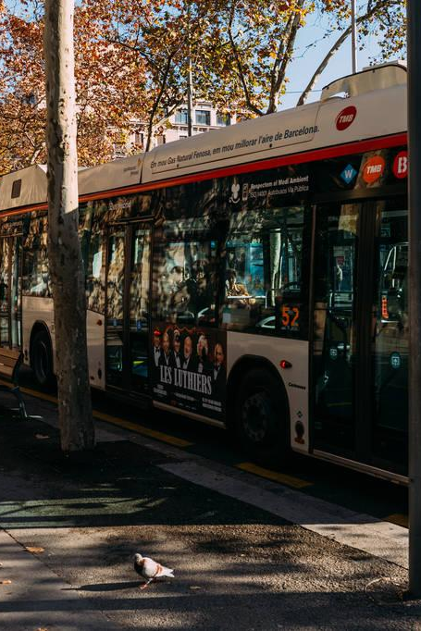
Research Problem
To examine several issues that hinder the optimal functioning of the BEST Bus Service, impacting the overall urban mobility experience in Mumbai.
Research Gap
Limited Focus on Accessibility and Inclusivity:
According to what I discovered, accessibility and inclusivity are critical aspects of a successful public transportation system, particularly in a diverse and densely populated city like Mumbai. Previous research has not extensively explored the specific measures needed to improve accessibility and inclusivity within the BEST Bus Service.

Slide 7
Research Methodology
Primary data collected through survey method
Questionnaire filled by 35 randomly selected respondents
Survey conducted among 15-65 years age group
Secondary data collected from websites, journals, and publications

Slide 8
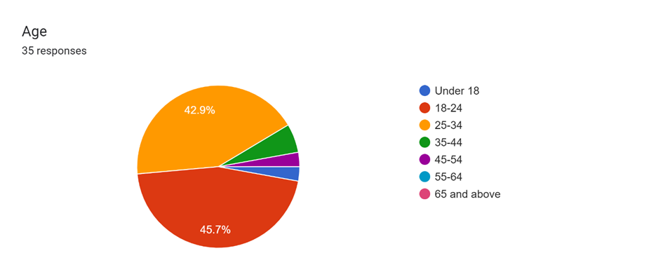
Data Analysis & Interpretations :
45.7% respondents are from age group 18-24 years.
42.9% respondents are from age group 25-34 years.
Green, Purple and Blue belong to the other age groups.

Slide 9
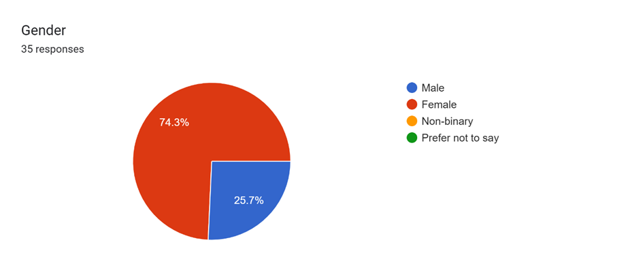
Data Analysis & Interpretations :
From the chart below, more than 70% respondents are Females and rest are the males

Slide 10
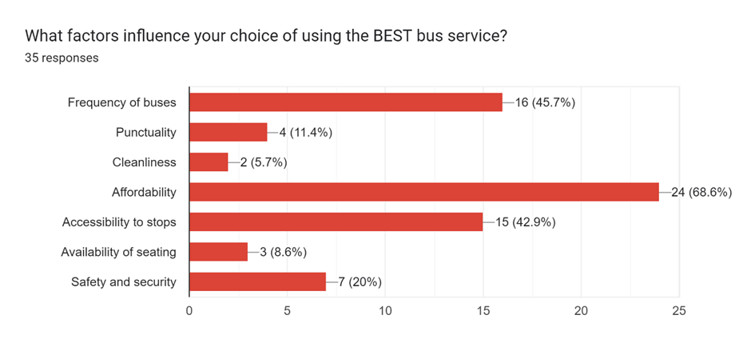
Data Analysis & Interpretations :
From this equation below, we can make out that most of the respondents are using BEST bus service due to affordability, frequency of buses, and due to accessibility to stops.

Slide 11
Limitations of the Study
Diverse commuters with varying characteristics and issues
Only 35 respondents as time constraints.
Biasness of the respondents could be the limitation as well

Slide 12
Findings of the Study
Improved accessibility features lead to higher user satisfaction
Increased bus service frequency leads to higher user satisfaction
Affordability positively affects user satisfaction
Technology-integrated services result in higher user satisfaction

Slide 13
The Backbone of Mumbai's Public Transit
The BEST bus service epitomizes Mumbai's public transportation network
Understand the dynamics of this service
Implications for urban planners, policymakers, and public transport authorities

Slide 14
Conclusion
In-depth analysis and insights into the BEST bus service in Mumbai
Potential as a model for urban mobility solutions
Recommendations for improving the transit system

Slide 15
Thank you for your time and attention 🙂

